Slide 1
Digital Program Overview
November 02, 2020
Jogi Nijjar

Slide 2
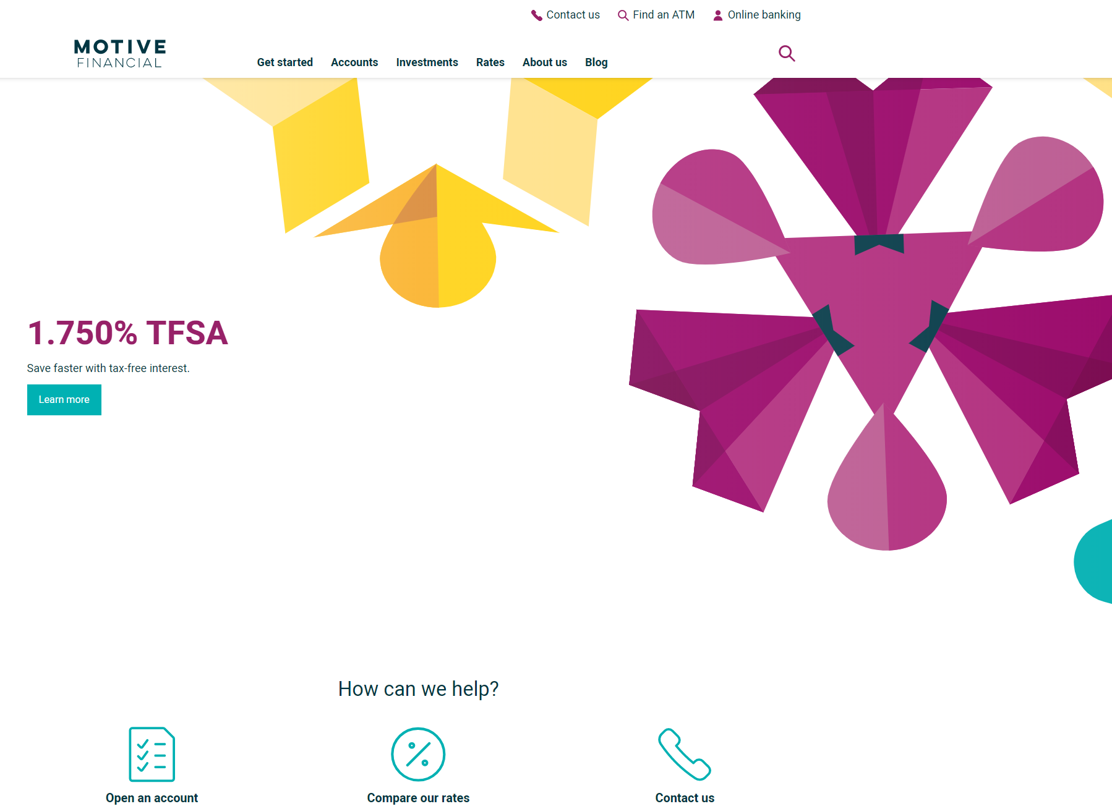
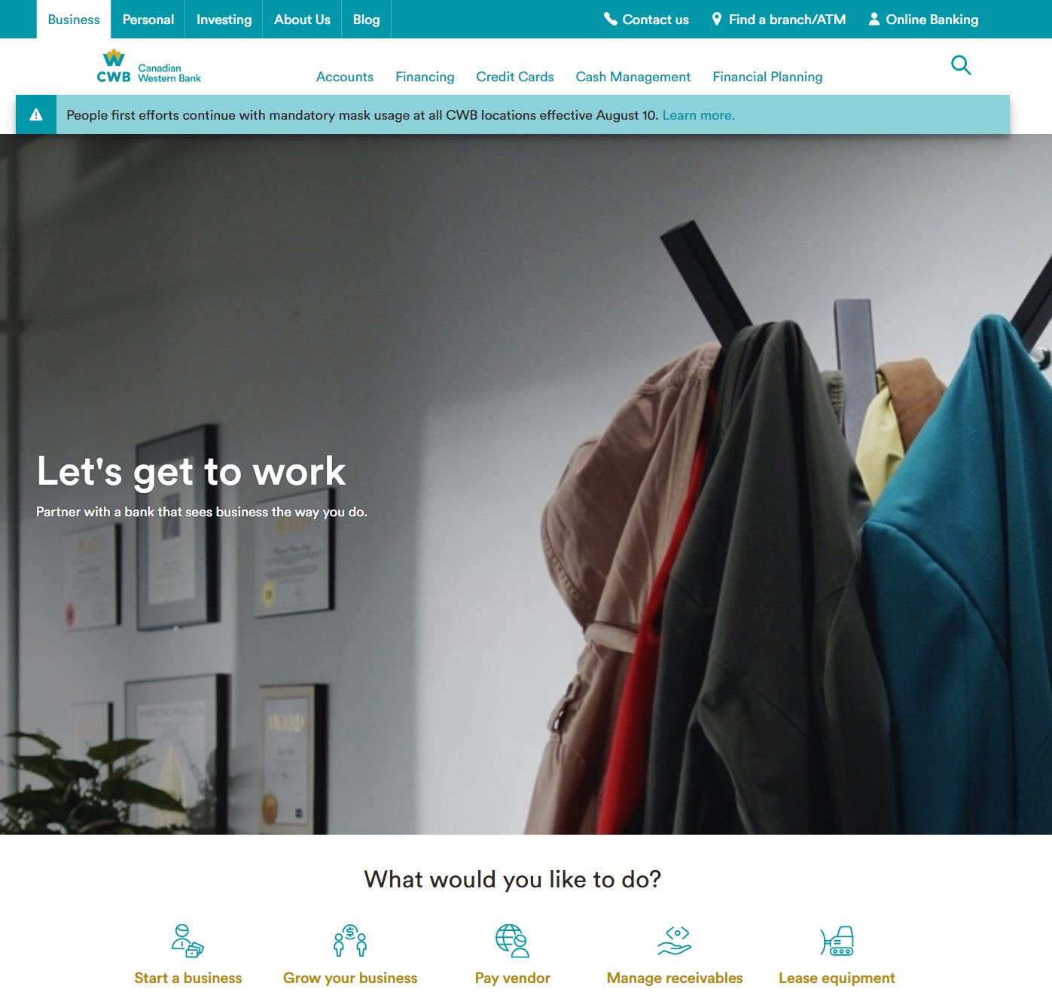
Digital Program – Motive vs CWB
Motive Financial
CWB
2019
2021
Today
Treated as branch within T24, not a different institution
More like a Business Unit
100% on-line, no branches, supported via call centre
Main “Bank”
More formal text, approach, philosophy
Many branches, supported via call centre in the future

Slide 3
Program Overview
The key goal of the Digital Program is to implement a Digital Client Onboarding processes and be a disrupter in offering unique Digital Banking products and services for Personal*, Small Business, and Commercial clients. The program governance defines the framework that will be established to effectively deliver the scope and enable the Digital Program benefits.
The first key project phase is Digital Client Onboarding (DCO), which includes new front-end web pages (using Temenos Infinity) for prospective personal clients to enter their personal data and submit a request for new clients to be created. A new back-end service (using Mulesoft and thirdstream) will be developed to facilitate account validations and T24 account creation processing without human intervention. The first launch is Motive in June (Friends and Family) with CWB Online and CWB In Branch following in the fall.
The second key project phase for Digital Banking (DB) will start mid-March with CWB initial requirements gathering and pre-planning already underway.
* Also know as “Retail” and “CWB”

Slide 4
Program Scope Summary
The Digital Program will deliver the following scope deliveries as project phases, using a core program team of shared resources:
Motive Digital Client Onboarding (Motive DCO – with go live versions MVP, MMP, Full)
Personal* Digital Client Onboarding (Personal DCO Online version & In Branch version)
Small Business Digital Client Onboarding (Small Business Online version & In Branch version) & Small Business Lending
Small Business Digital Banking Platform
Personal* Digital Banking Platform
Motive Digital Banking Platform
Commercial Digital Banking Platform
* Also know as “Retail” and “CWB”

Slide 5
High Level Benefits
The following high level benefits have been identified:
Reduce manual efforts that are currently required to open new accounts, and improve compliance and data integrity.
Digital Client Onboarding will offer personal and small business clients a much faster way to open deposit and lending products remotely, which will benefits prospective new clients who are outside of CWB’s current geographic branch footprint.
Reducing manual efforts required by CWB staff will improve the employee experience and allow them to focus on more value-add activities.

Slide 6
Measures of Success
Scope
The scope of the project aligns to the Project Charter and managed within the PMO framework.
Time
Delivery of the project within the planned schedule.
Budget
The project is completed within budget.
Quality
The digital client onboarding service is implemented per the agreed to requirements.
Benefits
Achieve the benefits identified in the Program Charter.

Slide 7
Program Governance & Delivery Framework
Executive Steering Committee
Sponsor Oversight
Stephen Murphy (Co-Chair), Darrell Jones (Co-Chair), Chris Fowler, Azfar Karimuddin, Jeff Wright, Christina Mullin, Jason Bond, TBD - Strategy & Corporate Development, Program Manager (Ex Officio)
Jeff Wright
Azfar Karimuddin
Governance
Program Owners
Christina Mullin
Jason Bond
Execution
Project Managers
Kate Jekabson
Dino Noce
Program Manager
Jogi Nijjar
Digital Program Advisory Committee (DPAC)
Branch & Department Managers
Functional Experts (SMEs)
HR
UAT Members
Change Champions
Delivery
Enterprise Risk Mgmt
Legal
IS Support
Client Solutions
Operations
OCM
AIRB/ARIB-SO
Risk IT
CRM
RDAAR
IRM
Regulatory
Compliance
Due Diligence
Guidance /
Support
Contract Review
Infrastructure
CISO
Info. Mgmt.
Application / QA
Business Analysis
Digital & Alt. Channels
Marketing
Sales Strategy & Effectiveness
Product Development
Banking Ops
CAPE
Lending Ops
Centralized Services
Credit Support
Change Impacts
Communications
User Training
Adoption
Engagement

Slide 8
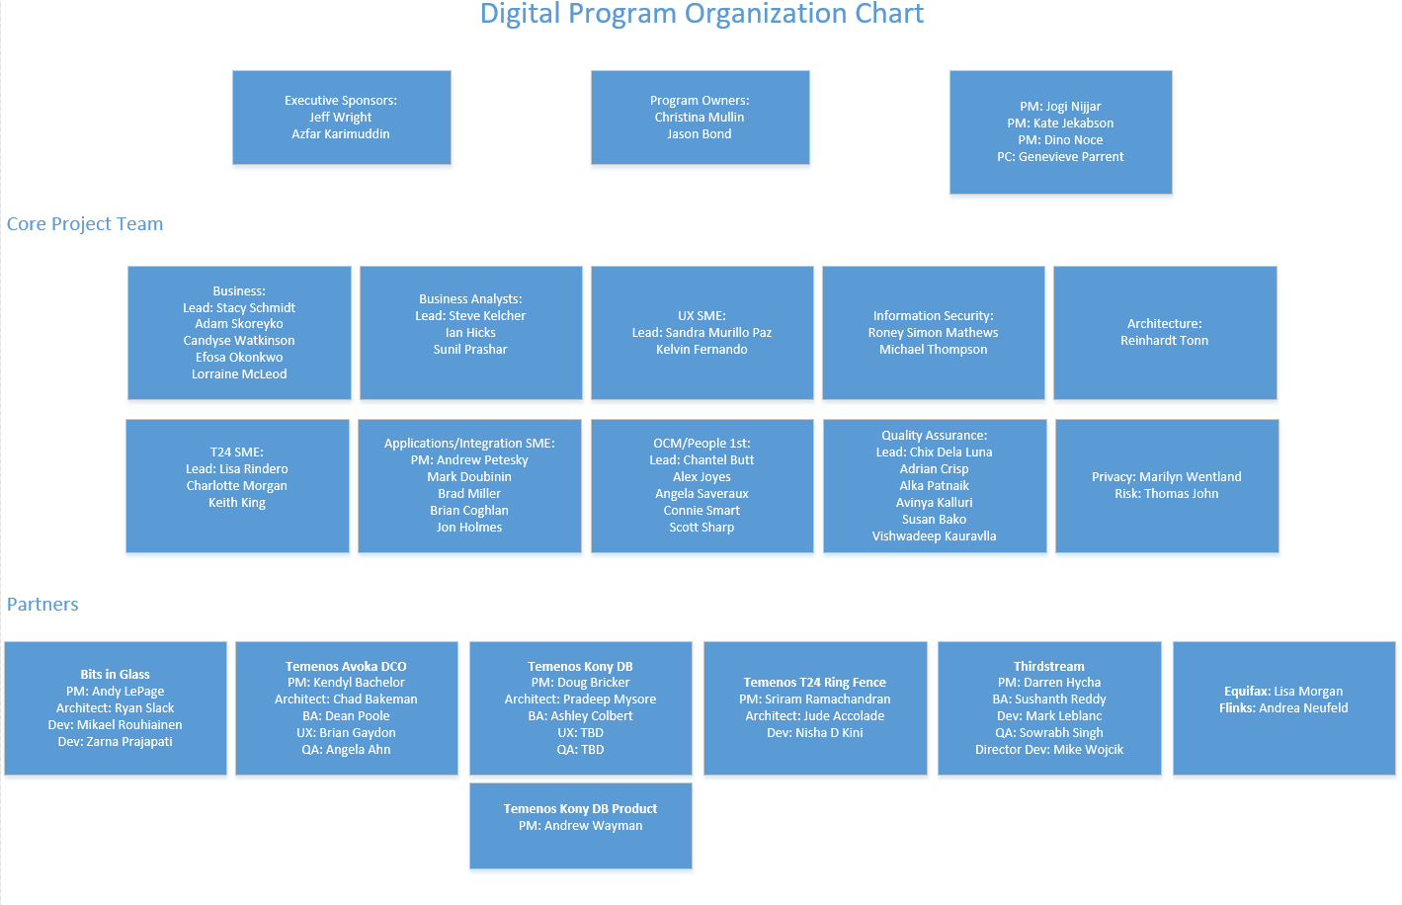
Project Organization

Slide 9
Project Team
 |  | PM |  |  | PC |  |  | OCM |  |  | Arch |  |  | BA |  |  | QA |  |  | Business |  |  | Security |  |  | UX |  |  | T24 |  |  | Integration/Application
Digital Client Onboarding Stream
 |  | Kate Jekabson |  |  | Genevieve Parrent |  |  | Trish Kushniruk |  |  | Reinhardt Tonn |  |  | Ian Hicks |  |  | Chix Dela Luna |  |  | Lorraine McLeod |  |  | Roney Simon Mathews |  |  | Kelvin Fernando |  |  | Keith King |  |  | Brian Coghlan
 |  | Jogi Nijjar |  |  |  |  |  | Allan Rib |  |  | Hardesh Marwaha |  |  | Steve Kelcher |  |  | Adrian Crisp |  |  | Candyse Watkinson |  |  | Michael Thompson |  |  |  |  |  | Lisa Rindero |  |  | Brad Miller
 |  |  |  |  |  |  |  | Alex Joyes |  |  |  |  |  | Roland Matsuba |  |  | Susan Bako |  |  |  |  |  |  |  |  |  |  |  |  |  |  | Mark Doubinin
 |  |  |  |  |  |  |  | Angela Saveraux |  |  |  |  |  |  |  |  |  |  |  | Stacy Schmidt
 |  |  |  |  |  |  |  | Robert Johnstone
 |  |  |  |  |  |  |  | Audrey Wedewer
Digital Banking Stream
 |  | Dino Noce |  |  | Genevieve Parrent |  |  | Trish Kushniruk |  |  | Reinhardt Tonn |  |  | Sunil Prashar |  |  | Alka Patnaik |  |  | Adam Skoreyko |  |  | Roney Simon Mathews |  |  | Sandra Murillo Paz |  |  | Charlotte Morgan |  |  | Brian Coghlan
 |  | Jogi Nijjar |  |  |  |  |  | Allan Rib |  |  | Hardesh Marwaha |  |  | Steve Kelcher |  |  | Vishwadeep Kauravlla |  |  |  |  |  | Michael Thompson |  |  |  |  |  | Lisa Rindero |  |  | Brad Miller
 |  |  |  |  |  |  |  | Alex Joyes |  |  |  |  |  | Neil Cory |  |  | Avinya Kalluri |  |  | Stacy Schmidt |  |  |  |  |  |  |  |  |  |  |  | Mark Doubinin
 |  |  |  |  |  |  |  | Angela Saveraux |  |  |  |  |  |  |  |  | Chix Dela Luna
 |  |  |  |  |  |  |  | Robert Johnstone
 |  |  |  |  |  |  |  | Audrey Wedewer
Additional Resources
 |  | Andrew Petesky |  |  |  |  |  |  |  |  |  |  |  |  |  |  |  |  |  | Francis Ho
Leadership
 |  | Kenneth Mastaller |  |  | Barb Keryliuk |  |  |  |  |  | Cory Gould |  |  | Tong Thai |  |  | Joanne Klausner |  |  | Christina Mullin |  |  | Cory Gould |  |  | Christina Mullin |  |  | Jason Bond |  |  | Jason Bond
 |  | Bruno Freitas |  |  |  |  |  |  |  |  | Kyle Bergum

Slide 10
Project Management Project Delivery Lifecycle
Monitoring and Controlling ensuring controls are in place to manage the project work
Performing Integrated Change Control
Initiation Phase
Project Kick off
Project Charter
New Initiative/Change Risk Assessment Tool
Project Management Plan
Develop project schedule and plans
SDLC: Requirements Gathering
Planning Phase
Monitoring and Controlling Phase
Direct and manage the work
Manage Communications
Perform quality assurance
Conduct procurement
SDLC: Design, Build, Test, Go Live
Execution Phase
Close of project or phase
Lessons Learned Report
Closure Report
Closure Phase

Slide 11
Constraints/
Dependencies
Constraints
The project will be using the Agile methodology with two week sprints, therefore work will be broken into multiple, two-week intervals.
Dependencies (updated as identified)
Digital Online Banking Project for Small Business and Personal;
CWB Mulesoft and Infrastructure Implementation Project;
AML Financial Crimes Project;
T24 Virtualization;
Sitecore Upgrade; and
Identity and Access Management.

Slide 12



Strategic Partners
Partners are critical to the successful delivery of the Digital Program
Temenos
Digital Online & Mobile Apps
Onboarding
Personal Banking
Digital SME Platform
Commercial/Corp Banking
Bits & Glass
Mulesoft APIs
Onboarding
T24
Wave
Payments (C1, WU etc.)
Third Party Partners
Thirdstream
KYC/AML
Equifax
Trans Union
Enstream
Fraud
Watchlist
Business Registries

Slide 13












T24 Ringfence team
Avoka team
Kony team

Slide 14
NIRAP – First Program Focus – Motive DCO (April 30)
The first program scope focus will be Motive – Digital Client Onboarding and includes the following:
Deployment of the Temenos Infinity Digital Client Onboarding (DCO) Platform to digitalize the existing and manual Motive processes. This includes workflow management, analytical reporting, user access setup. Environments hosted on a Temenos Cloud.
Implementation of Digital integration layer using Mulesoft framework software (enterprise bus). Environments on premise.
New supporting integrations to be orchestrated through Mulesoft:
thirdstream: Canada Post (address suggestion, correction and prefill), Amazon SNS (SMS notifications), ThreatMetrix (device and IP fraud screening), IDScan (identity document prefill), Equifax Credit Check, Flinks (authentication only), Equifax AML Assist/Citadel Fraud, EnStream (mobile phone verification)
Temenos T24: new web services: create customer, create contact log, create account, create Access Card (PAC, create PPAN( and update PAC code (for card access and linkage), check for existing customer duplicate customer check.
New CWB Digital Team support
and sustainment structure
Service Name | Thirdstream API | Providers
External FI Search Service (IAV) | Account Verification API | Flinks
Fraud Check Service | Fraud Detection API | Citadel-Equifax and ThreatMetrix
Address Search Service | Address Search API | Canada Post Address Complete
ID Scan Service | Identity Verification API | ID Scan
AML Compliance Service (IDV) | AML Compliance API | AML Assist-Equifax and Enstream
Credit Bureau Check Service | Credit Bureau API | Equifax Credit Check
n/a | n/a | Amazon SNS

Slide 15
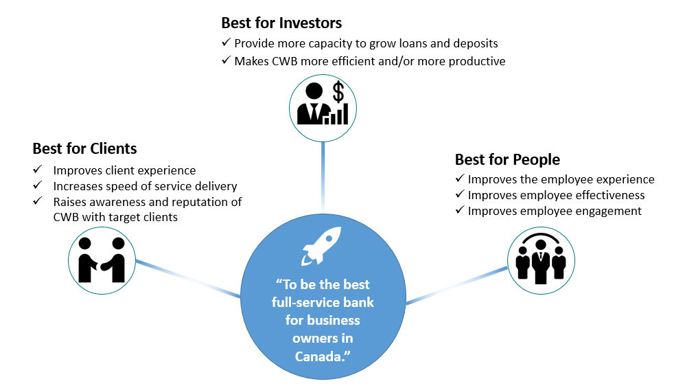
Business Objectives and Strategic Alignment
The Digital program supports the following key strategic objectives:

Slide 16
Key Program Benefits
Best for Investors:
Attracting new clients which will increase loans and deposits will benefit investors.
Reducing manual efforts that are currently required to open new accounts will improve efficiency and productivity.
Best for Clients:
The modern and distinct products/services that will be delivered by the Digital Program will improve client experience though improving the functionality of the online systems, and offering clients tools they don’t have access to elsewhere.
Digital Client Onboarding will offer personal and small business clients a much faster way to open a new account remotely, which will benefits prospective new clients who are outside of CWB’s current geographic branch footprint.
Best for People:
Reducing manual efforts required by CWB staff will improve the employee experience and allow them to focus on more value-add activities.
Staff are clients of the bank, and will benefit from the improved experience that will be delivered by the personal changes in the Digital Program, and in particular the enhancements to personal online banking.

Slide 17
Digital Program – Roadmap Summary
2020
2021
* CWB OCM year end impacts
Mar
Apr
May
Jun
Jul
Aug
Sep
Oct
Nov
Dec
Jan
Feb
Mar
Apr
May
Jun
Jul
Aug
Mar
Mar
Mar
Mar
Mar
Jan 29
Mar
2019
Friends & Family Launch, June 22, 2020
2021
Motive DCO Project – Initial Implementation
Canada Wide, July 20, 2020
Oct 31, 2020 – Go Live Ready
75 days
Today
Nov 08, 2020 * Personal DCO Online Soft Launch
Personal DCO Online (Client) Project & Motive DCO Project – Full Implementation
Nov 08, 2020 * Motive DCO Full Go Live
Nov 29, 2020 * Personal DCO Online Canada Wide Go Live
116 days
May 2020
Personal DCO In-Branch (Staff) Project - Full Implementation
Nov 22, 2020* Personal DOC In-Branch Pilot
Jan 10, 2021* Personal DCO In-Branch Canada Wide Go Live
Dec 2020
DCO HF
Jan 2021
DCO HF
201 days
Program Stream 1
Dec 2020 SB DCO/Lending Planning Session
Includes Online (Client) & In-Branch (Staff)
On Pause
Digital Client Onboarding (DCO aka Temenos Avoka)
Jun 1, 2020
Small Business DCO Project
March 2021 – Go Live Ready
To be released with Small Business Banking in early 2021
Small Business Lending
130 days
Dependent Projects
Forms Project: Motive Oct 30
Forms Project: CWB Jan 30
SAS-AML Project: Go Live mid-Oct
129 days
Credit Card Project – Brim – Go Live Nov 2020 Stand Alone
Credit Card Project – Brim – Go Live April 1
Mar 2020
Note: Digital Banking dates will be updated as CWB works with Temenos; official CR pending
54 days
Pre-Planning
Mar 2020
April 2021 Go Live
Summer 2021
Small Business Banking Implementation - Small Business Banking Launch (Initial Focused Launch)
Enhancements
225 days
April 2021 Go Live
XAI/Real time engagements Phase 1
246 days
Mar 20, 2020
May 2021 – Go Live Ready
Retail/Personal Banking Implementation
May 2021 – Go Live Ready
Program Stream 2
Motive Banking Implementation
192 days
Nov 2020
August 2021 Go Live Ready
Digital Banking (DB aka Temenos Kony)
Corporate Banking Implementation

Slide 18
Program Stream 1: Scope Summary
Program Stream 1 (Digital Client Onboarding): Motive Digital Client Onboarding CWB Web Personal Digital Client Onboarding Small Business Digital Client Onboarding In-Branch Personal and Small Business Digital Client Onboarding CWB Small Business Lending | The first key stream is focused on Digital Client Onboarding through the Temenos Infinity platform for prospective retail and small business clients. The deployment of the Temenos Infinity Digital Client Onboarding (DCO) Platform (aka. Temenos Avoka) will digitalize the existing and manual account opening processes for retail and small business clients. This includes webpage design, workflow management, analytical reporting, and user access setup on environments hosted on Temenos Cloud. This program stream will also focus on the implementation of a Digital integration layer using Mulesoft framework software (Enterprise Service Bus). New supporting integrations to be orchestrated through Mulesoft include: thirdstream: Canada Post (address suggestion, correction and prefill), Amazon SNS (SMS notifications), ThreatMetrix (device and IP fraud screening), IDScan (identity document prefill), Equifax Credit Check, Flinks (authentication only), Equifax AML Assist/Citadel Fraud, EnStream (mobile phone verification). Note: The above listing denotes Motive/Personal services with additional Small Business services to be defined during the Small Business DCO phase. Temenos T24: new web services: create customer, create PAC, create PAN (for card access and linkage), check for existing customer Finally, this program stream will establish the new CWB Digital Team support and sustainment structure.

Slide 19
Program Stream 2: Scope Summary
Program Stream 2 (Digital Online Banking Platform): Small Business Online Banking Platform Personal Digital Online Banking Platform Commercial Digital Online Banking Platform | The second key program stream is the implementation of Temenos Infinity is their digital online banking platform (aka Temenos Kony) product for retail, small business and commercial clients; replacing the existing Central 1 online banking platform that CWB currently uses. This program stream is focused to provide an enhanced client user experience, seamless migration of clients’ accounts, preferences and historical data/transactions, as well as providing additional product/feature/services not available in CWB’s current online banking platform. This stream will also focus on the integration of Central 1’s API for payment/settlement processing services through the Mulesoft ESB and enhancement of T24 web services as needed.

Slide 20



Architecture for Partner Services
Temenos Infinity:
Lead partner for staged implementation of all client facing online and mobile services, branch access, API Integration to Mulesoft
New to Bank
unsecured
Mobile
secured
Internet
secured
Call Centre
Branch
Agent
Chat-bot
API
Journey Manager User Journeys (New-to-Bank & Existing Customers)
Temenos UXP & CMS
User Agents (Bank Staff & Customers)
Marketing
Single Customer View - CRM
Servicing
Bits & Glass:
Will lead development and testing for Mulesoft API services, integrating to Infinity, T24, Payment systems, Wave, Thirdstream & 3rd party partners
Real-time Engagement
Customer Profitability
Engagement Decision Engine
Watchlist
Money Mgmt/PFM.
Sales
Marketing Catalogue
Account
Aggregation
Predictive Analytics
KYC
Onboarding
Origination
Payment Order
Workflow
Alerts &
Notifications
Contact log
Journey/
Clickstream Analytics
AML
Fraud
Document Management
Secure Messaging
Decisioning Rules
Business Support
Embedded Analytics
Thirdstream
Responsible to provide services that will complete non face to face validation for both personal and business customers
User
Management
Consent
Reporting Dashboard
Document
Output
Monitoring & Logging
Holdings
Analytics &
Reporting
Risk &
Compliance
API layer
API layer
API layer
API layer
Core banking engine [T24 R12]

Slide 21
Architecture
Banking
Draft Only

Slide 22
Architecture
Banking
Draft Only

Slide 23
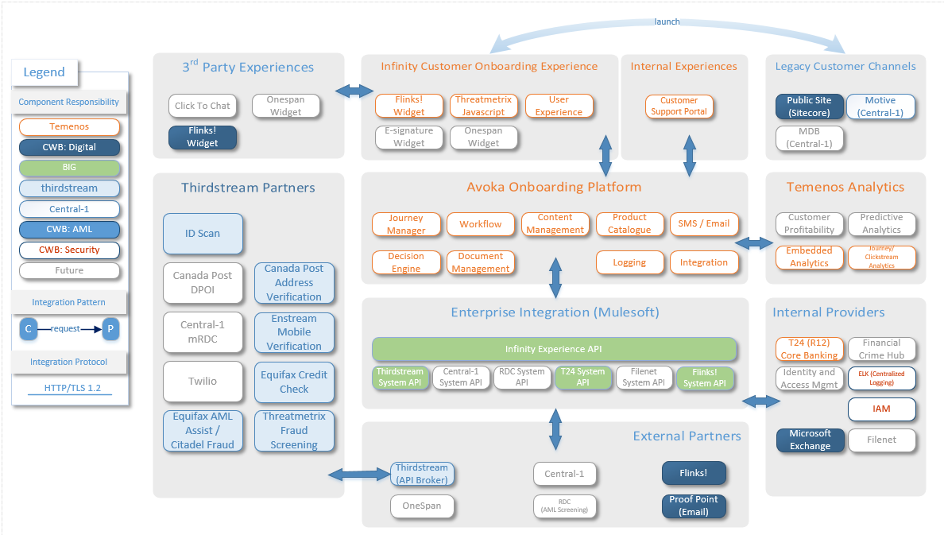
DCO – Context Diagram DCO
Draft Only

Slide 24
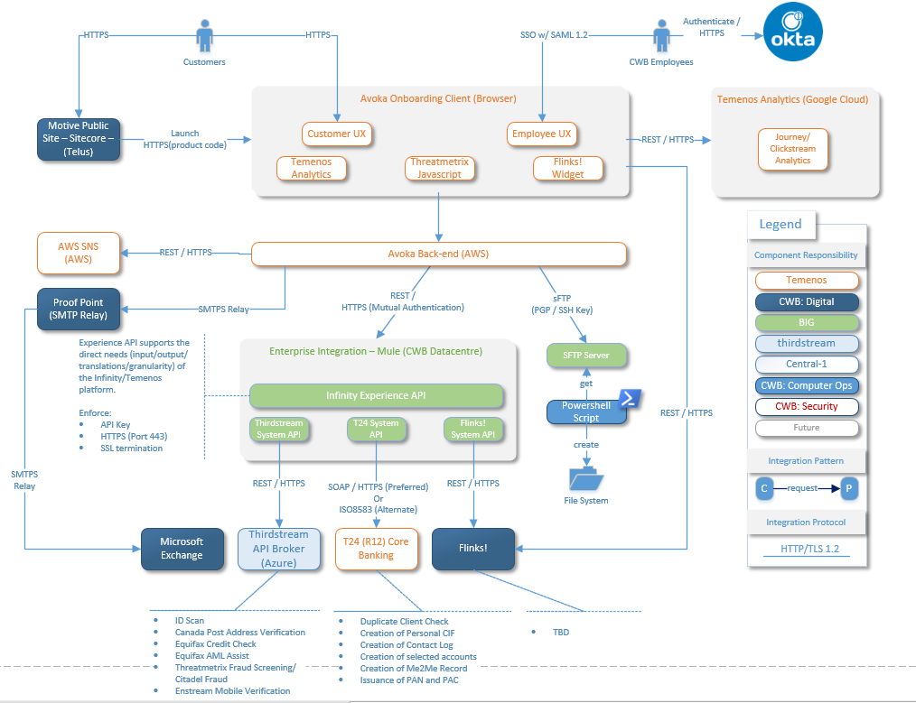
DCO – Integration Diagram
Draft Only

Slide 25
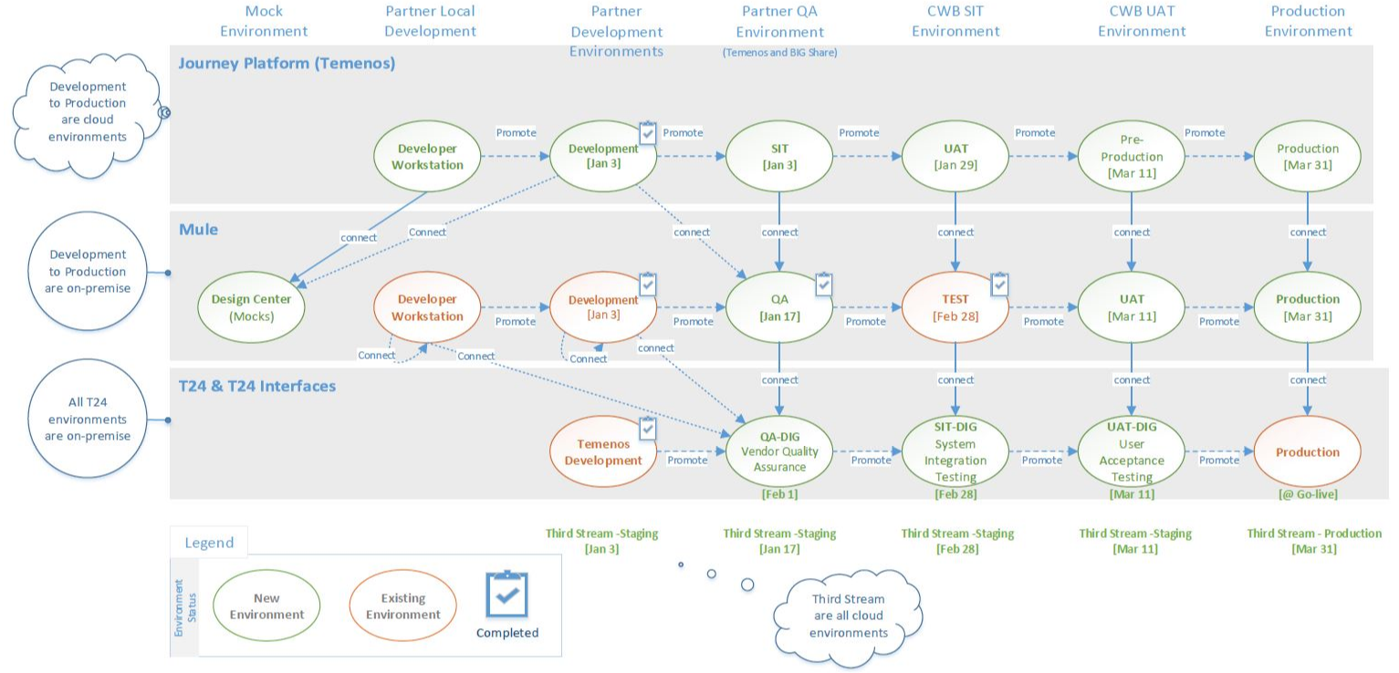
Digital Program – Environment Map (with due dates)
2020
2020
Today

Slide 26
DIGITAL PROGRAM
Organizational Charts – All Partners
http://sp.cwb.local/projects/pmo2/Digital%20Program/Digital%20Program%20SharePoint/1%20Program%20Management/04.%20Monitoring%20and%20Controlling/Communications/Organizational%20Charts-%20All%20Partners.pptx

